Slide 1
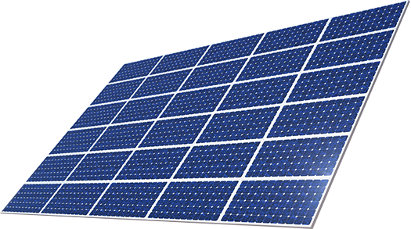

Load
MPPT
Battery
Electrolyzer
$H_{2}$ Storage Tank
Fuel Cell
Water input
Air Input

Slide 3
PV curve through out the year
We can observe that the lowest curve of the PV is in December where the maximum gain is 120 KW and the most time interval the PV cannot meet the load demand (9H) per day.
So this the month we are going to choose as to calculate the battery demands.

Slide 6
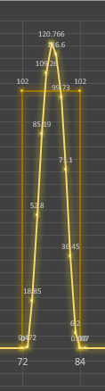
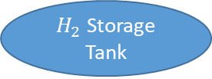
Load
MPPT
Battery
Electrolyzer
$H_{2}$ Storage Tank
Fuel Cell
Water input
Air Input

Slide 7
Battery Calculations and selection

Slide 8
Objectives
1- Function of battery.
2- Key strategy of calculations.
3- Parameters of calculations.
4- Selection of batteries.
5- Comparing between different alternatives.

Slide 9
Function of battery
Guarantee a minimal autonomy according to the testing requirements.
“in our case the sun will always shine so there is no autonomy days”
2. Act as a buffer to supply power when the power
sources are unable to meet the demand from the
motors and to level current peaks.
“In this case the power source is the photovoltaic.”

Slide 10
Key strategy in battery calculation
To ensure a robust system the battery must be qualified to ensure continuous power supply for the load.
So we are going to observe the system load curve with the PV power generation curve and choose the worst case scenario.
Worst case:
Choosing the minimum power coming from the independent source in our system which is the photo voltaic and calculating the power needed to be covered from another independent power source “battery in this case” is the key of calculation.

Slide 11



Battery calculations
1- Series:
2- Parallel:

Slide 12
Battery calculations
“Before we calculate the number of batteries we must know some important parameters”
1- Output voltage = load voltage = 220 volt
2- Load energy WH = ( load KW) * (hours of operation)
= 102 KW * 9 = 918 KWH
3- Type of battery chosen : dependent on that
The battery voltage / The battery AH / The price

Slide 13
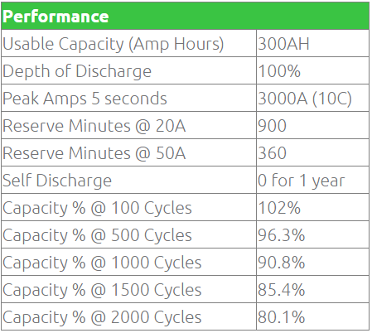
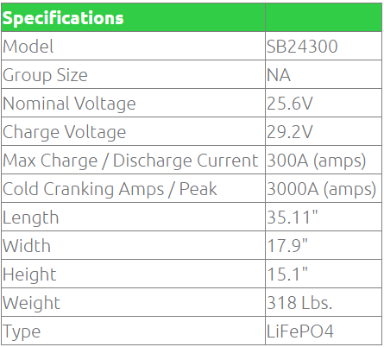
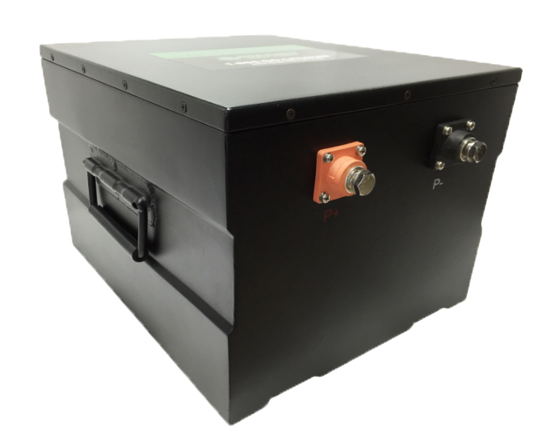
24V 300AH Lithium-ion Battery
Case 1 (DOD 100%)
Batteries in Series: 10 Batteries in parallel: 14
Total number of batteries: 140 Weight: 20.2 tons
No. of cycles= 100 Price: 910000$
Case 2 (DOD 8o %)
Batteries in Series: 10 Batteries in parallel: 18
Total number of batteries: 180 Weight: 26.2 tons
No. of cycles= 200 Price: 1170000$
PRICE: $6,499.99
Weight: 320 lbs
The Smart Battery 24V 300AH Deep Cycle Lithium Ion Battery offers state of the art technology "Lithium Iron Phosphate" the safest and most robust lithium chemistry. Capable of reaching over 5000 cycles, The SB24300 can be re-charged thousands of times providing 100% DOD (depth of discharge) The Smart Battery SB24300 is perfect for Solar, Marine, RV and commercial applications
Site: https://www.lithiumion-batteries.com/products/24-volt-lithium-batteries/sb24300.php

Slide 14
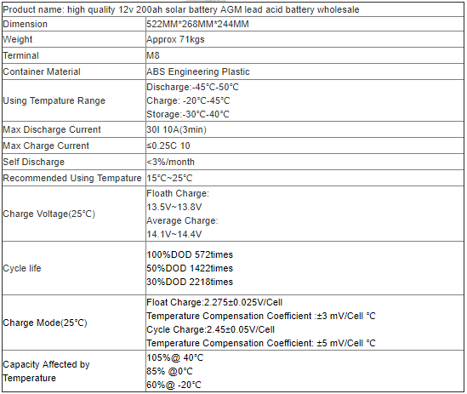
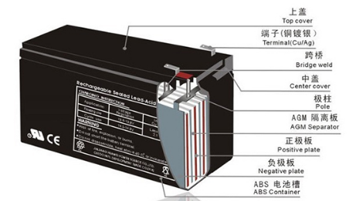
Lead acid battery (AGM)
Case 1 (DOD 100%)
Batteries in Series: 19 Batteries in parallel: 21
Total number of batteries: 399 Weight: 28.2 tons
No. of cycles= 572 Price: 24000$
Case 2 (DOD 5o %)
Batteries in Series: 19 Batteries in parallel: 26
Total number of batteries: 494 Weight: 35 tons
No. of cycles= 1422 Price: 29640$
Site: https://www.alibaba.com/product-detail/high-quality-12v-200ah-solar-battery_1807662936.html?spm=a2700.7735675.2017115.1.GNungZ&s=p

Slide 15
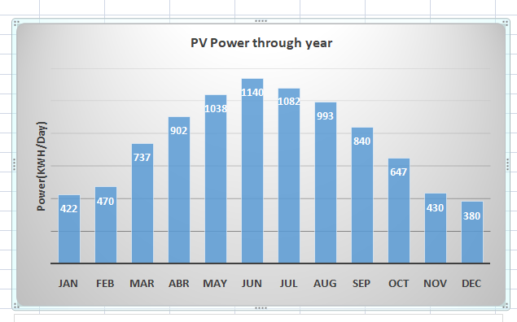
Calculating the amount of charge and discharge
To ensure that the battery would be sustainable for operation for the next days we must make sure our batteries gets to SOC 100% again “Definition of cycle”
Of course we are going to see the power gained by the PV and see if it going to be sufficient for our batteries – which is a load now.
In December the PV gain is the least in Cairo 380 KWH , so by simple mathematics the load demand is 918 kwh in 9 hours so we got 3 hours left from the day these hours the charger controller will redirect the energy
from the PV to the load “solar priority “ and the left energy will be charging the battery
since load demand is 303 KWH for 3 hours the left is 74kwh to charge the battery (8% of total capacity)
Therefore we will need about 12 days to charge the batteries again
So the it’s abvious the battery would never be able to sustain the load

Slide 16
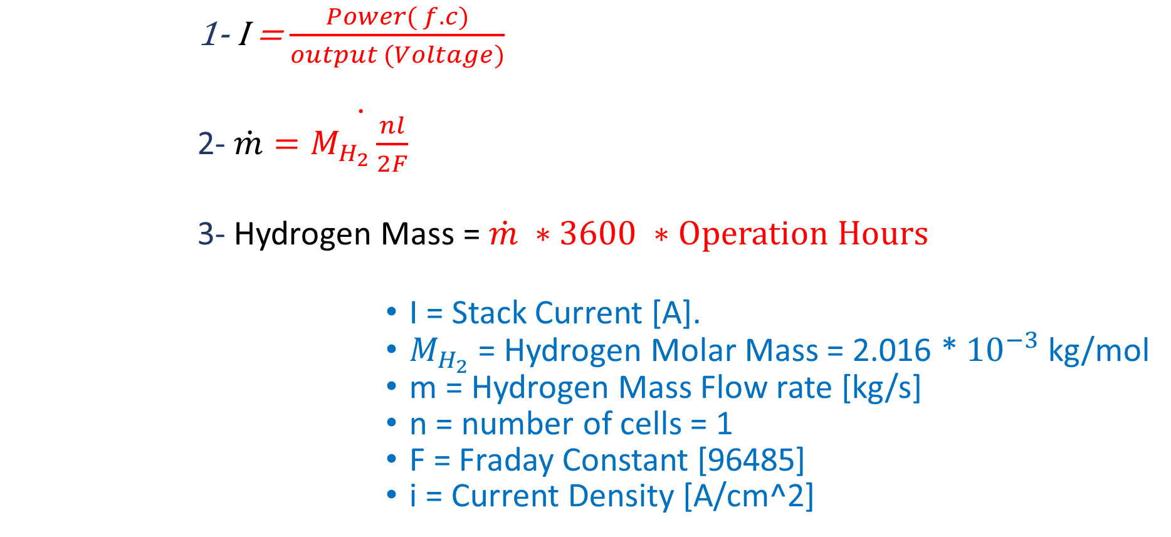
Hydrogen Mass Calculations
1- I = $\frac{Power( f.c)}{output (Voltage)}$
2- $\dot{m}\dot{=M_{H_{2}}\frac{nl}{2F} }$
3- Hydrogen Mass = $\dot{m} ∗3600 ∗Operation Hours$
I = Stack Current [A].
$M_{H_{2}}$ = Hydrogen Molar Mass = 2.016 * ${10}^{−3}$ kg/mol
m = Hydrogen Mass Flow rate [kg/s]
n = number of cells = 1
F = Fraday Constant [96485]
i = Current Density [A/cm^2]

Slide 17
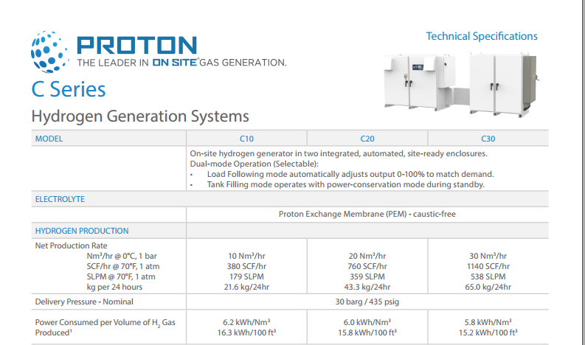

Slide 18
PV-Battery –Fuel Cell system
Constant Parameters
Period of operation Load demand
6 – 11 510 KWH
11 – 2 306 KWH
2 – 6 408 KWH

Slide 19
SCENARIOS

Slide 20
Scenario 1
Fuel cell power = W85kw
Mass of hydrogen = 36.15 kg/day
Tank capacity = 700 liter
Charging Time = 1.4 Min
In this case batteries number will decrease dramatically
and the extra KWH will be used to produce hydrogen
for the next days.
Period of operation | Load demand (KWH) | Fuel Cell KWH | Battery KWH | PV KWH
6-11 | 510 | 500 | 10 | -
11-2 | 306 | - | - | 306
2-6 | 408 | 400 | 8 | -

Slide 21
Scenario 2
Fuel cell power =100 KW
Mass of hydrogen =30.73 kg/day
Tank capacity = liter 690
DOD of battery = 9%/day
Period of operation | Load demand (KWH) | Fuel Cell KWH | Battery KWH | PV KWH
6-11 | 510 | 425 | 85 | -
11-2 | 306 | - | - | 306
2-6 | 408 | 340 | 68 | -

